Slide 1

The New Statistics

Slide 2
Outline
Drawing statistical inferences
The p-value
‘New statistics’ to improve statistical inferences
Effect sizes
Confidence intervals
Power

Slide 3


Slide 4
{drawing statistical inferences}
You find that people who call while driving get, on average, into 0.58 more accidents than people who do not call while driving?
Does this mean that people who call while driving get into more accidents?

Slide 5
{drawing statistical inferences}
To make this decision you need to conduct an inferential statistical test, that is, draw statistical inferences.
What does this mean?
Null Hypothesis Significance Testing

Slide 6
{p-value}
The p-value is defined as the probability, calculated under the null hypothesis, that a test statistic is as extreme or more extreme than its observed value.
The null hypothesis is typically rejected — and the finding is declared statistically significant
— if the p-value falls below a certain threshold,
e.g., α = 0.05.

Slide 7
{p-value}
What does it *not* mean if a test yields p = .03?
* It’s an important effect — see practical significance, effect size
* It’s a stable effect - see CIs
* It is 97% likely that the effect is true or ‘real’ — see power

Slide 8
{effect sizes}
The p-value indicates how likely the observed effect is under the H0.
It says nothing about the size of the effect, its practical significance.
The effect size is the magnitude, or size, of an effect.

Slide 9
{effect sizes}
You ask a sample of 300,000 students how much they spend per month on movies, and you also ask them how much they like movies on a 1 to 7 scale, where 1 = “Not at all” and 7 = “Very much”.
You find that Crime Science students spend 18GBP and like movies on average 4.8 and Psychology students spend 18.03GBP and like movies on average 5.3. Both differences between Crime Science and Psychology students are statistically significant.
But are they meaningful?

Slide 10
{effect sizes}
When looking at differences between groups:
Effect size = M1 - M2
SD
Cohen’s d, Glass Delta, Hedges’ g
For correlational data:
r correlation, R² coeff. of determination, eta² Cohen’s f²

Slide 11
{effect sizes}
Calculate effect sizes online.
Effect size calculators help you ‘translate’ different effect sizes.

Slide 12
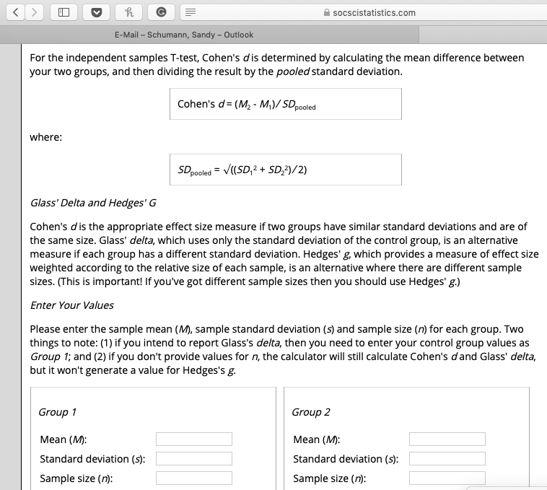

Slide 13
{effect sizes}
Most effect sizes in the social sciences are moderate.
The average size of an effect across 100
years of social psychology is r = .21 (Richard et al., 2003).

Slide 14
{confidence intervals}
Effect sizes refer to point estimates. In addition, it is valuable to consider an interval estimate, called confidence intervals.
Confidence intervals can be calculated for different statistical parameters. Typical intervals are 95% or 99% CIs.

Slide 15
{confidence intervals}
If a study is replicated an indefinite number of times and if a 95% confidence interval is computed for the difference of sample means each time, the true difference of the population means will fall within these intervals in 95% of all replications .
5 out of 100 will miss it, but 95 out of 100 contain the actual population value.
However: NOT that the true population value is with 95% in these boundaries

Slide 16
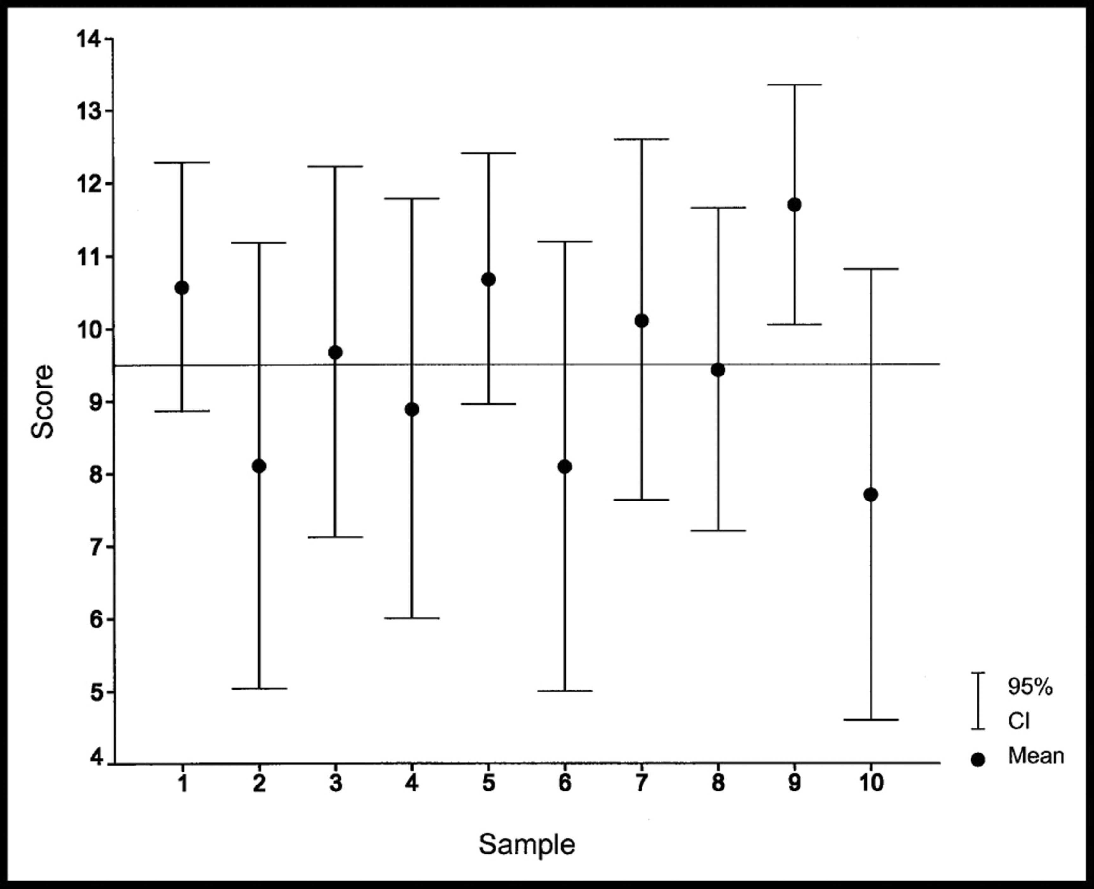
From: Statistical Inference by Confidence Intervals: Issues of Interpretation and Utilization
Phys Ther. 1999;79(2):186-195. doi:10.1093/ptj/79.2.186
Notes:
Figure 2. Graphic representation of the data presented in Table 2. The solid horizontal reference line represents the population mean of 9.5. The 95% confidence interval (CI) for the ninth sample fails to include the population mean; it is as likely as not that this will be the case for 1 in 10 samples. This CI is actually the narrowest of the 10 CIs, illustrating the fact that the precision expressed by a CI is independent of its accuracy.

Slide 17
{confidence intervals}
A measure of ‘accuracy’: wider confidence intervals indicate less precise estimate, larger margin of error
Lower and upper bounds indicate reasonable boundaries of the population estimate

Slide 18
{confidence intervals}
Calculate 95% confidence interval of group mean difference:
I = [(x₁ – x₂ ) – 1.96*σdiff, (x₁ – x₂ ) + 1.96*σdiff ]
with σdiff = (σ1²/n1 + σ2²/n2)^{1/2}
1.96 = confidence coefficient

Slide 19
{true effects}

Slide 20
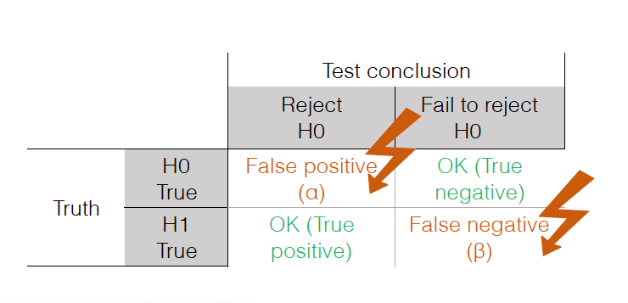
{power}

Slide 21
{power}
Statistical power is the probability that a
study yields a statistically significant effect, if
there is a true effect to be found. It is the
probability of correctly rejecting the null
hypothesis.
Power = 1 - β

Slide 22
{power}
Statistical power is determined by:
• the size of the effect in the population
• the sample size (easiest to assess)
• the significance criterion

Slide 23
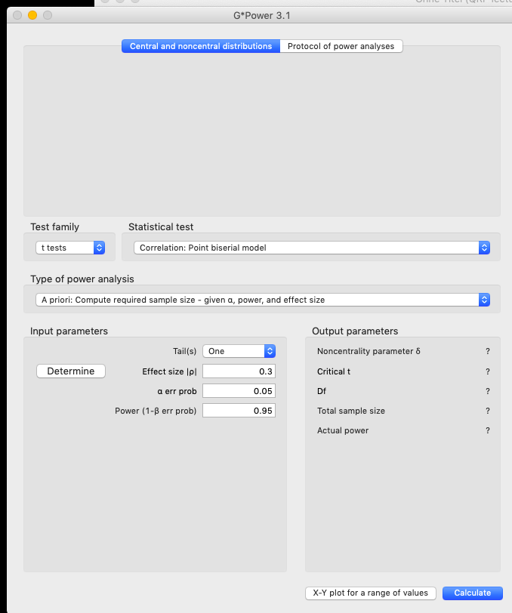

Slide 24
Check List
Be careful if a low-powered (small-N) study
yields a low p-value. It might be a false positive effect.
Consider the effect size
Calculate the CI
Assess the power

Slide 25
Thank You

